Slide 1
Combining Reinforcement Learning and Search for Cooperative Trajectory Planning
Timo Klein

Slide 2
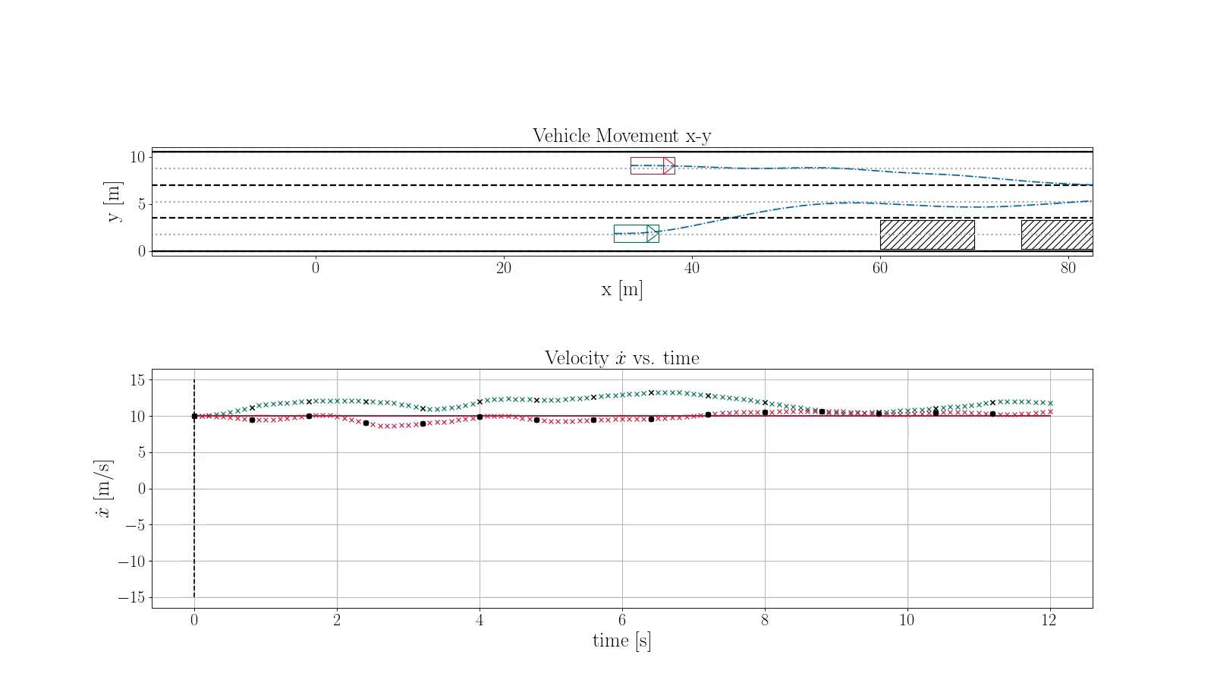
Cooperative Trajectory Planning
Motivation
Approach
Evaluation
Conclusion
Sources: Kurzer et al. (2018)

Slide 3
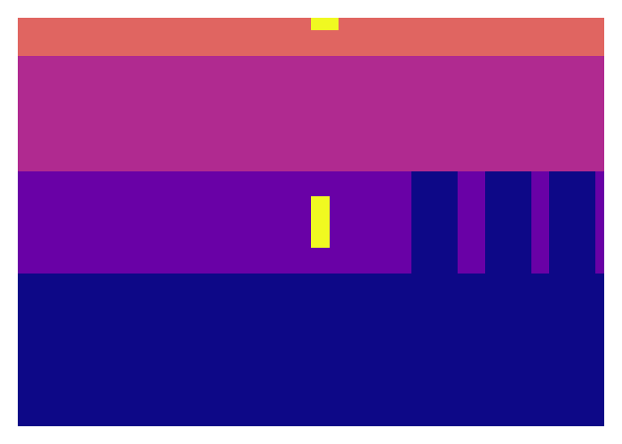
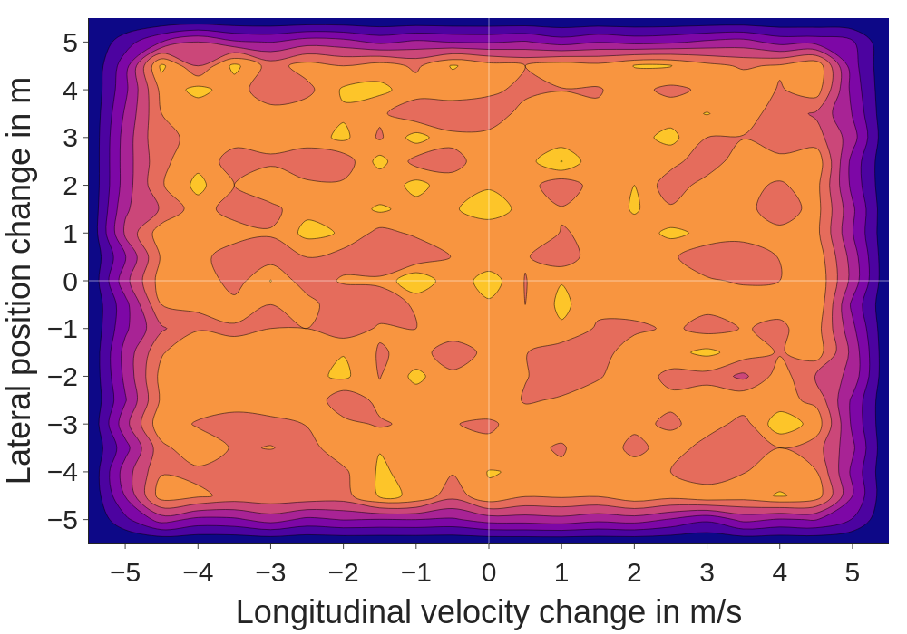
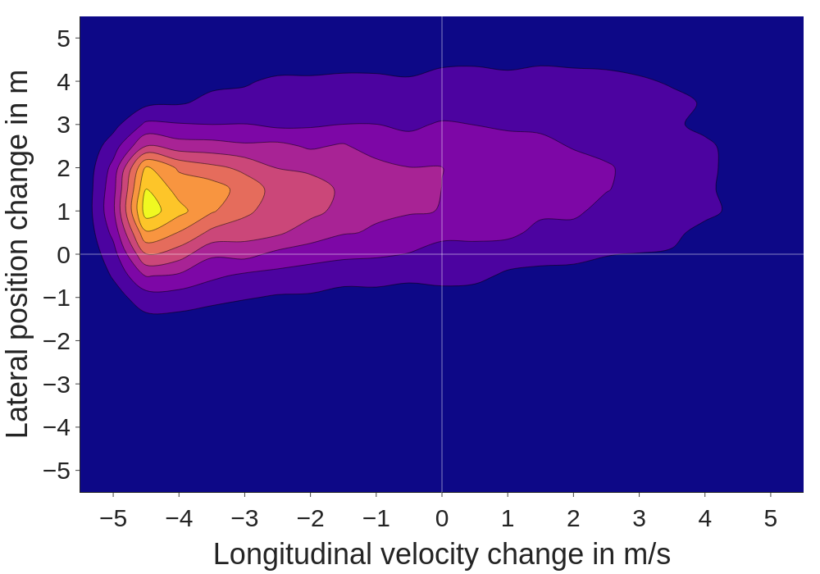
Research Question
Uniform sampling in 2D continuous action space is inefficient
Goal: Increasing sample efficiency through focused sampling
Method: Integrate learned knowledge into the search
Visual input
Sample space
Motivation
Approach
Evaluation
Conclusion
Notes:
Looking at the image: Right turn does not make sense (driving off the road)
Uniform sampling “wastes” half the actions
How can we generate high-quality proposal distributions?

Slide 4
Reinforcement Learning and Search
Action space
Discrete
Continuous
§
AlphaGo
(
Silver
et al.)
§
A0C
(
Moerland
et al.)
§
AlphaGo Zero
(
Silver
et al.)
§
Continuous
MuZero
(Yang et al.)
§
AlphaZero
(
Single
Silver
et al.)
§
Sampled
MuZero
(Hubert et al.)
agent
§
MuZero
(Schrittwieser et al.)
§
SAVE
(
Hamrick et al.
)
Number of
§
Tactical Decision
(
Hoel
et al.)
agents
§
Multiplayer
AlphaZero
§
This
work
(
Petosa
et al.)
Multi
agent
Motivation
Approach
Evaluation
Conclusion
Notes:
AlphaZero family of algorithms (MuZero learns a model)
SAVE applies Q-Learning and does not directly learn a policy
Hoel et al. apply AlphaGo Zero to autonomous driving
A0C extends AlphaZero to continuous action spaces
Yang and Huber extend MuZero to continuous action spaces
This work is built on A0C
Multiplayer AlphaZero generates value estimates for multiple agents
This work directly plans in continuous action spaces (unlike Hoel) It plans for multiple agents (unlike A0C)

Slide 5





Monte Carlo Tree Search (MCTS)
Selection
Expansion
Simulation
Backpropagation
$$Δ$$
$$Δ$$
$$Δ$$
$$Δ$$
Leaf node
Expandable
Non-terminal
Simulation
Outcome $Δ$
Motivation
Approach
Evaluation
Conclusion
Sources: Browne et al. (2012)
Notes:
Descend the tree until an expandable leaf node is reached
Expand the tree by adding a new node
Estimate value with Monte Carlo rollout
Backpropagate the value estimate up to the root node

Slide 6
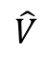
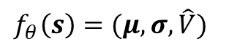
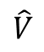
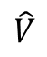
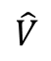
Concept: Guided MCTS
Selection
Expansion
Simulation
Backpropagation
$$\hat{V}$$
$$\hat{V}$$
$$\hat{V}$$
$$\hat{V}$$
$$f_{θ}\left(s\right)=(μ, σ, \hat{V})$$
Motivation
Approach
Evaluation
Conclusion
Sources: Moerland et al. (2018), Silver et al. (2017), Silver et al. (2017)
Notes:
Guided search needs to change only one stage: Simulation stage!
Instead of rollout, we add value estimates and proposal distributions
Backpropagate value estimates

Slide 7
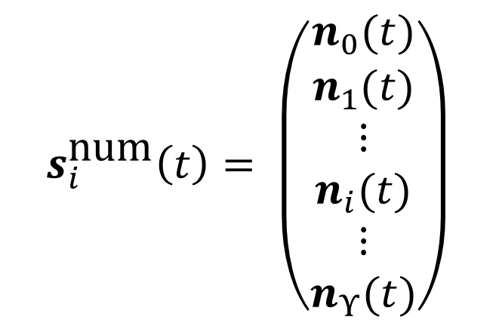
Problem 1: Input Representation
Visual map
Agent trajectories
$$s_{i}^{\text{num}}\left(t\right)= \left(\begin{matrix}n_{0}(t) \\ n_{1}(t) \\ \begin{matrix}\begin{matrix}⋮ \\ n_{i}(t)\end{matrix} \\ \begin{matrix}⋮ \\ n_{Υ}(t)\end{matrix}\end{matrix}\end{matrix}\right)$$
Trajectory of agent 1 relative to the ego agent i
Motivation
Approach
Evaluation
Conclusion
Sources: Kurzer et al. (2020), Bacchiani et al. (2019)

Slide 8

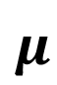
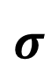
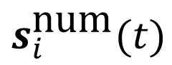

Problem 2: Flexible Number of Agents
W
$$μ$$
Trajec-tory
Emb.
Multi-
Head
Attn.
Add
&
Norm
Feed Fwd.
Add
&
Norm
MLP
Policy
$$s_{i}^{\text{num}}(t)$$
$$σ$$
+
$$\hat{V}$$
Conv
Poo
l
Conv
Conv
Conv
Conv
Conv
Conv
Poo
l
Conv
Conv
Motivation
Approach
Evaluation
Conclusion
Sources: Kurzer et al. (2020), Wang et al. (2020), Bacchiani et al. (2019), Vaswani et al. (2017)
Notes:
How can hybrid representation with flexible number of agents be processed?
Agent always has only one map -> Processed by CNN CNN uses skip connections and channel attention (ECA-Net)
Flexible number of agent trajectories
First embedded, then learned positional embeddings are added [Allow the network do disambiguate agents]
Transformer encoder learns interactions between agents
Agent features are concatenated with visual features
Parameter shared MLP policy outputs proposal distributions and value estimates for all agents

Slide 9
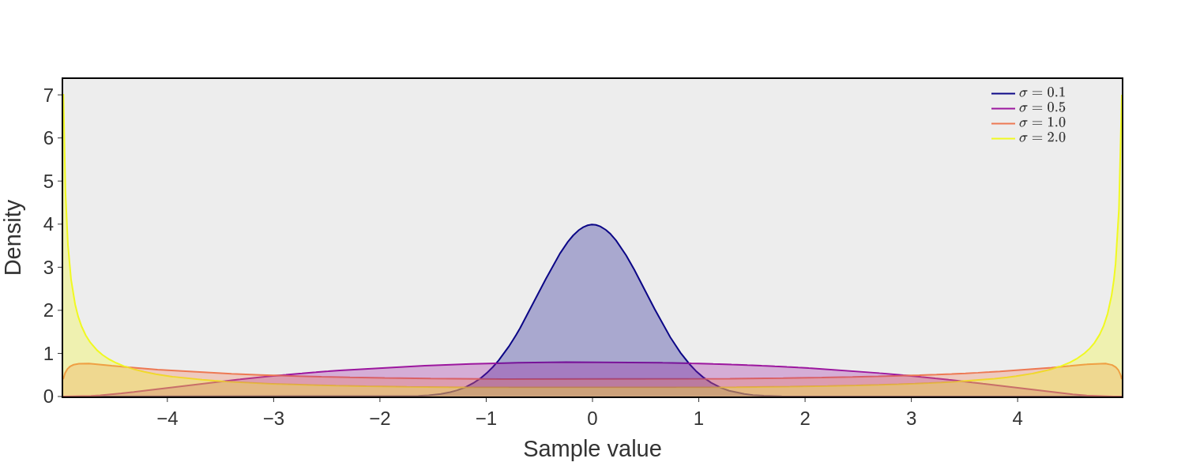
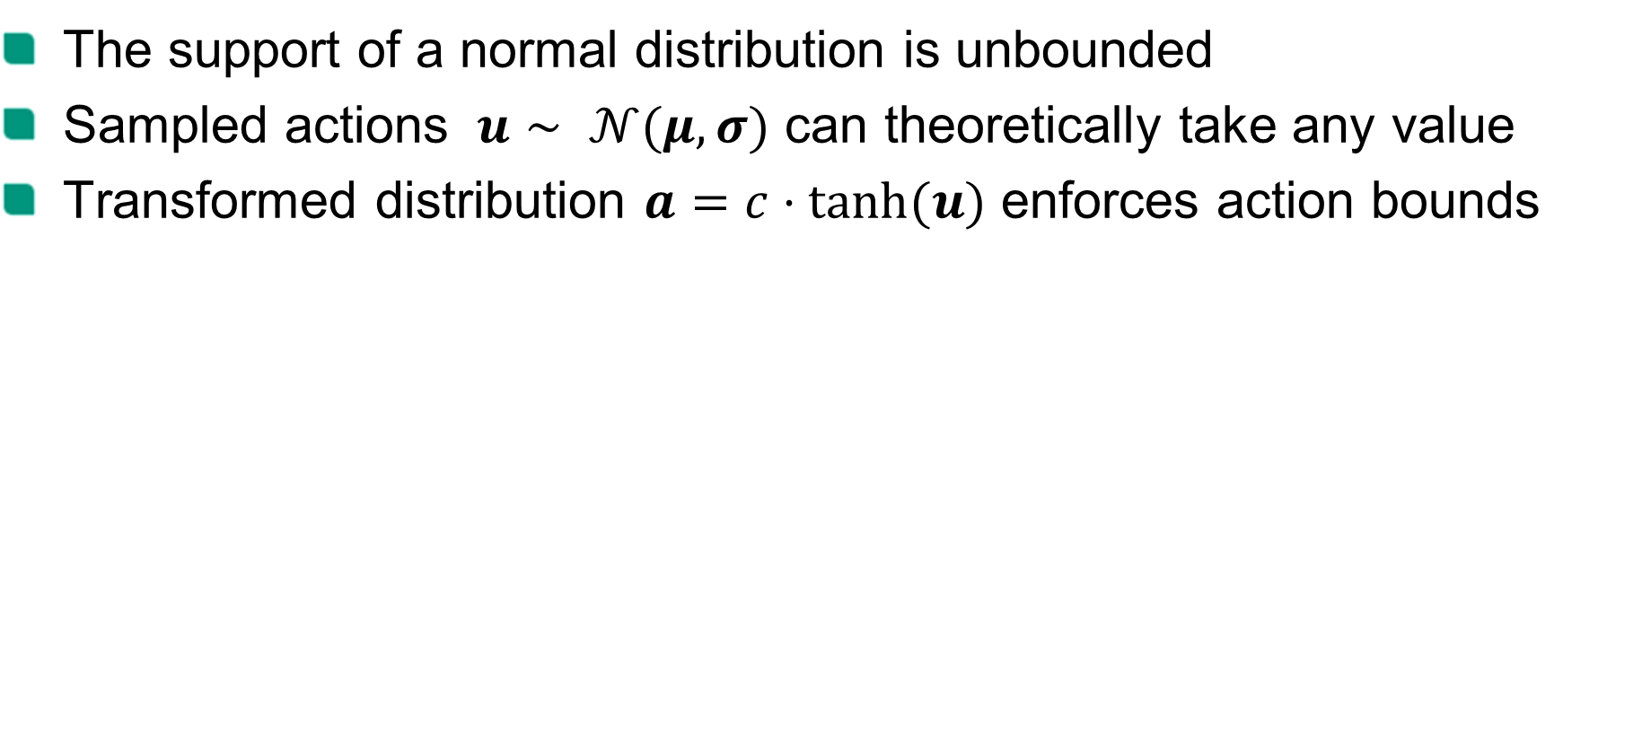
Problem 3: Constraints of Vehicle
The support of a normal distribution is unbounded
Sampled actions $u∼ 𝒩(μ, σ)$ can theoretically take any value
Transformed distribution $a=c⋅\tanh{(u)}$ enforces action bounds
Motivation
Approach
Evaluation
Conclusion
Sources: Haarnoja et al. (2018)
Notes:
Support of a Normal distribution is unbounded
Samples can take arbitrary values!
First squash samples with tanh, then re-scale with factor c [Added benefit: Transformed distribution is more flexible -> Useful for e.g. exploration]

Slide 10

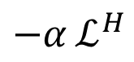
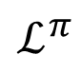
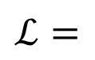

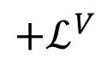
Training
$$ℒ=$$
$$ℒ^{π}$$
$$−α_{ }ℒ_{ }^{H}$$
$$+ℒ_{ }^{V}$$
Train Network
Training procedure
Store data in replay buffer
Store updated parameters
$$θ$$
Generate training experiences
Motivation
Approach
Evaluation
Conclusion
Sources: Moerland et al. (2018), Haarnoja et al. (2018)
Notes:
Generate training data [Initialized with random neural network]
Store data in a fixed-size FIFO replay buffer
Train the network. Loss consists of:
Policy component Goal: Move proposal distribution closer to policy improved through MCTS
Entropy component Goal: Prevent distribution collapse and encourage exploration
Value component Goal: Learn value estimates to truncate MCTS rollouts
Store new params once network is trained
Repeat with new params

Slide 11
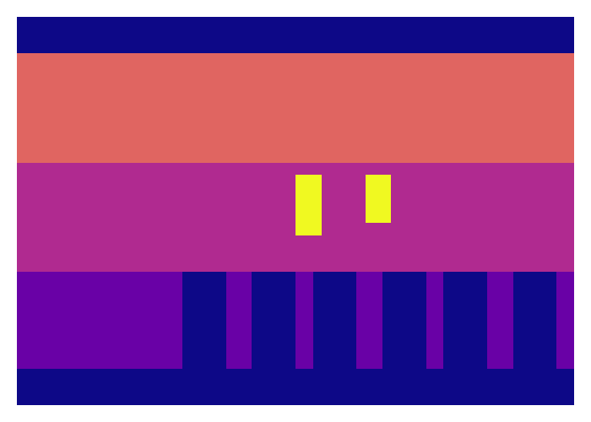
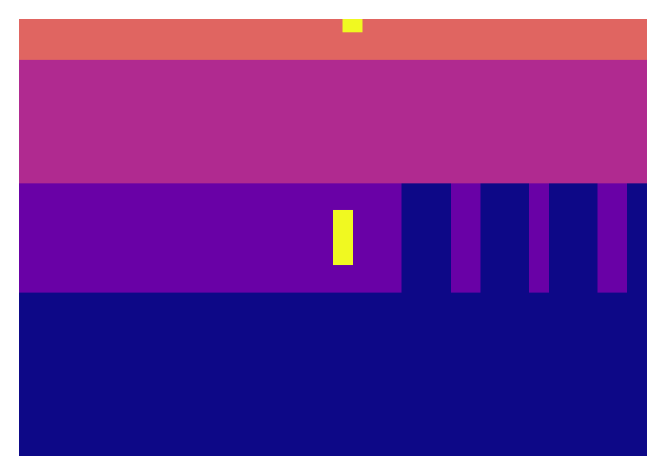

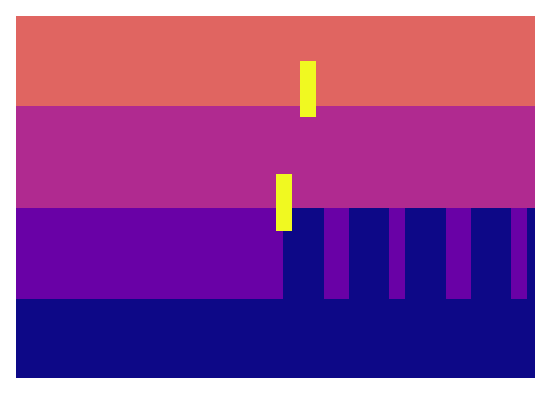
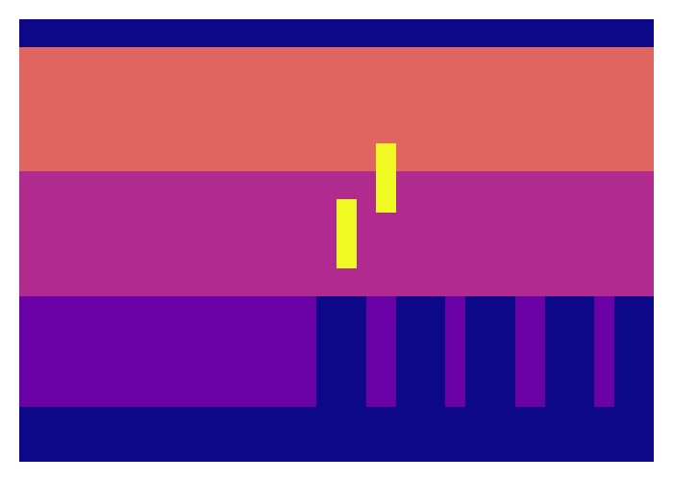

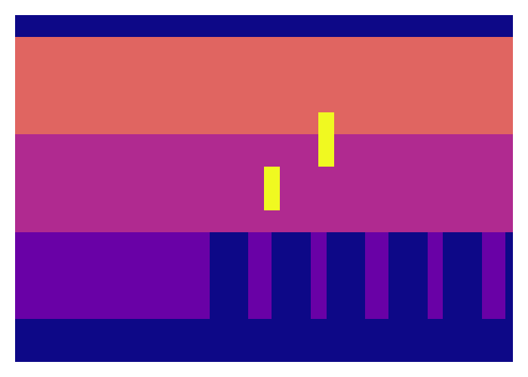
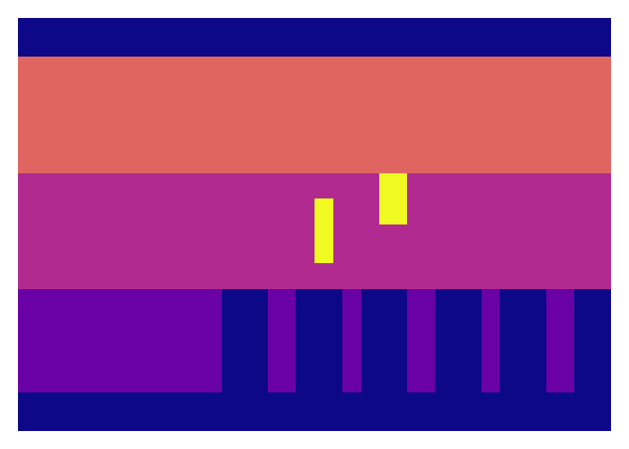
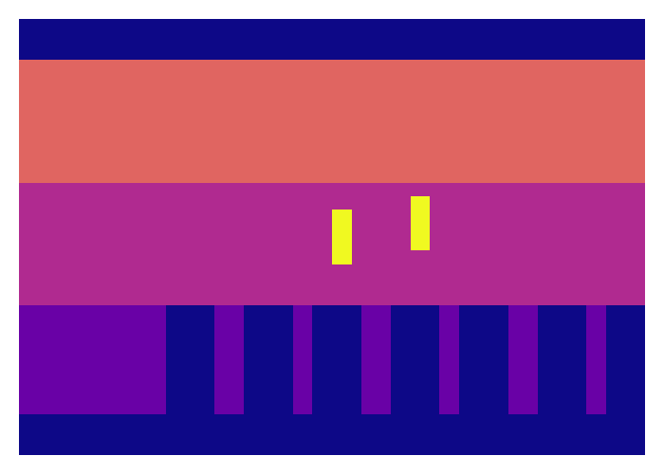
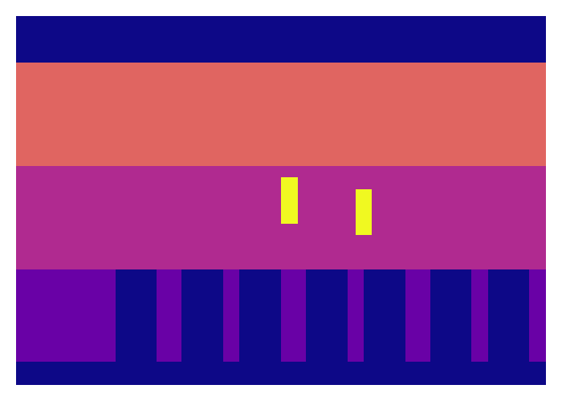
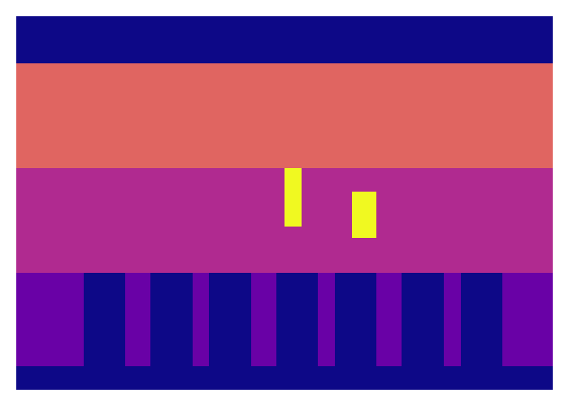
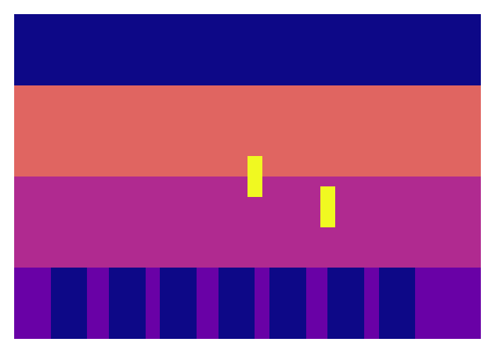

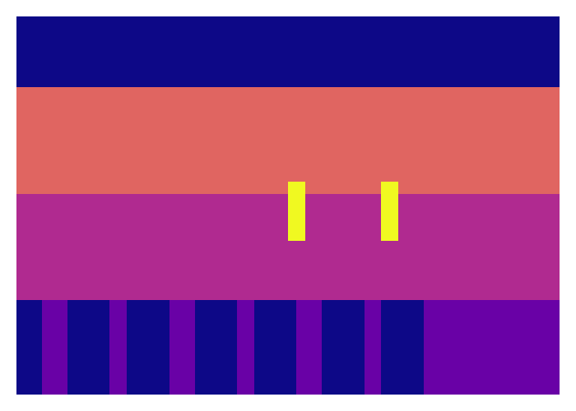
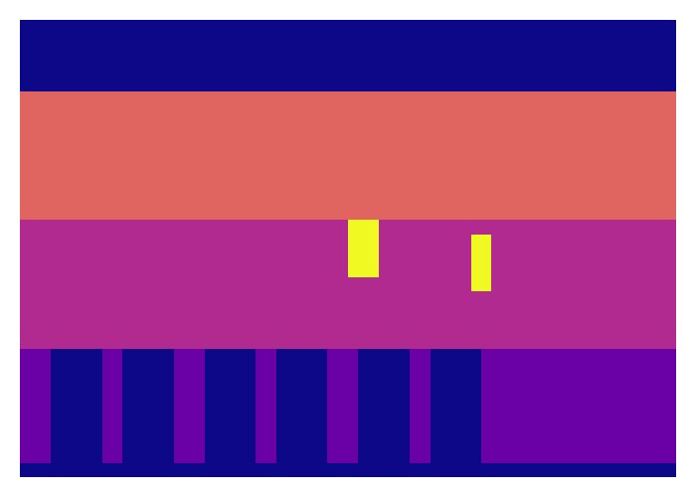
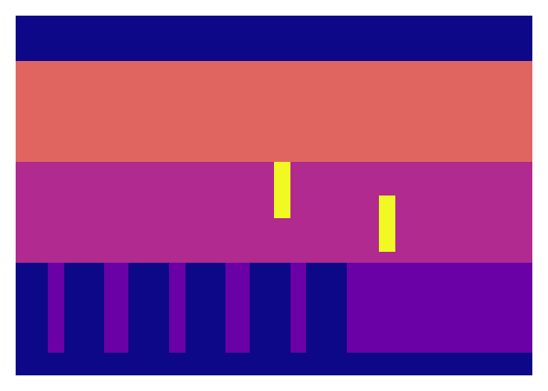
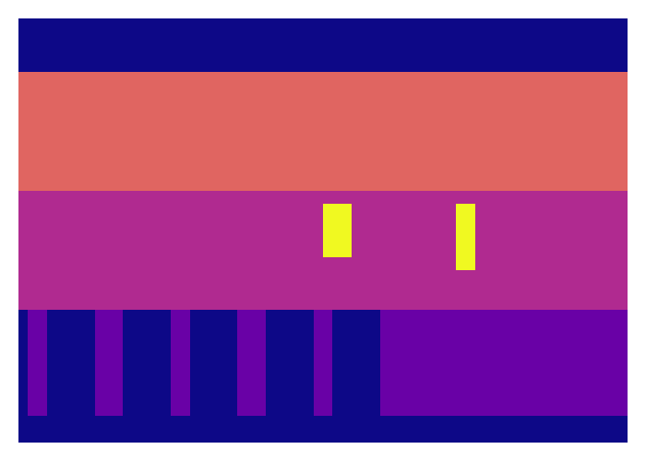
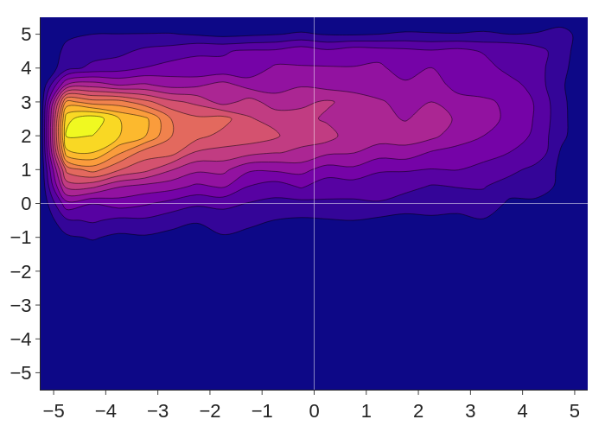
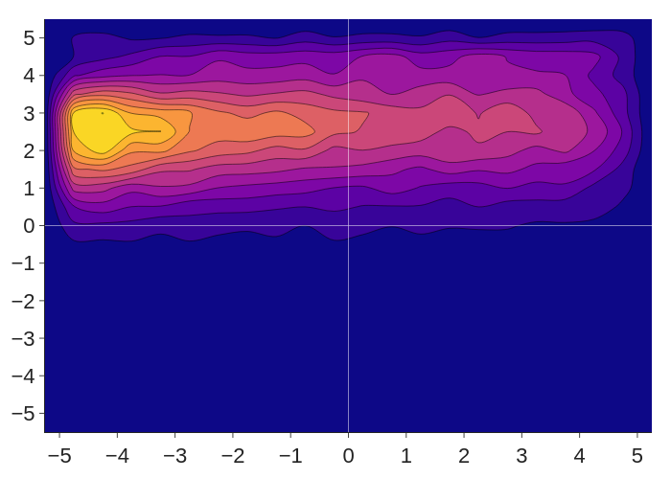
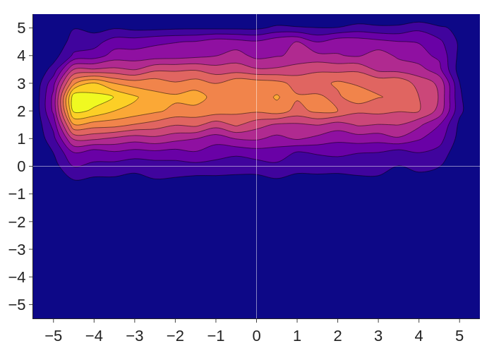
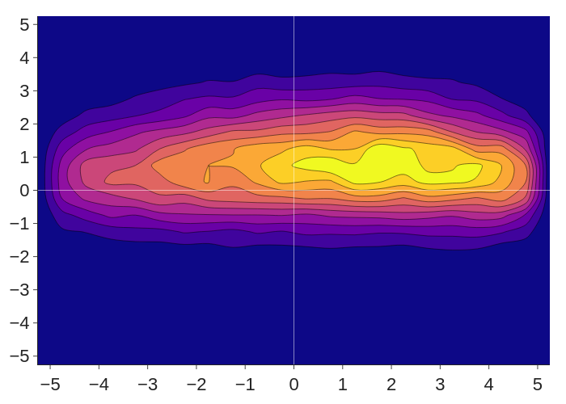
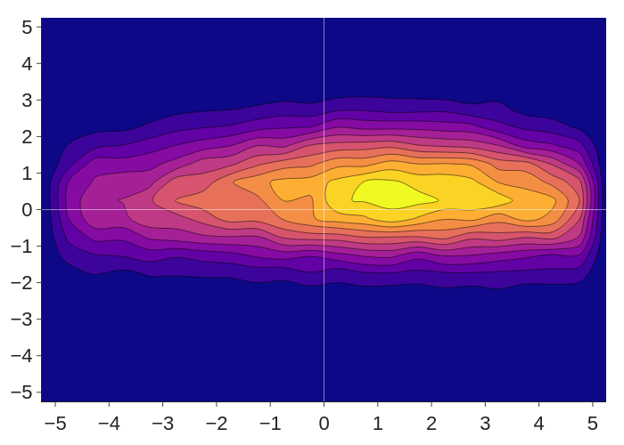
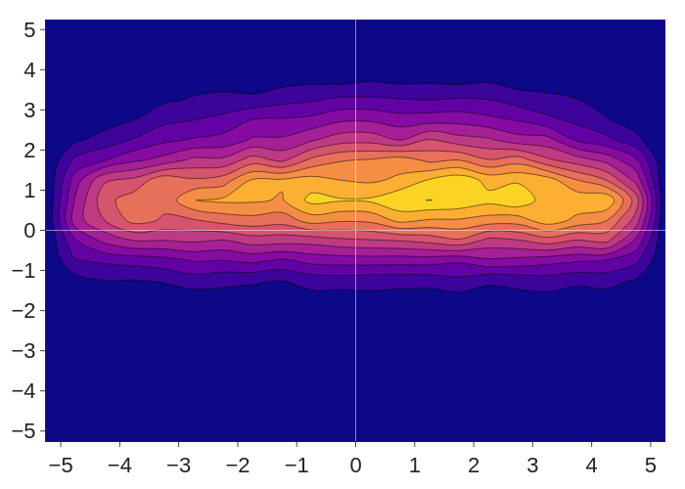
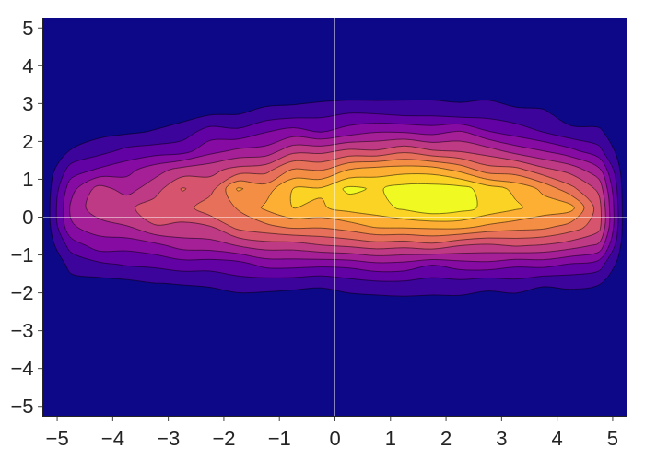
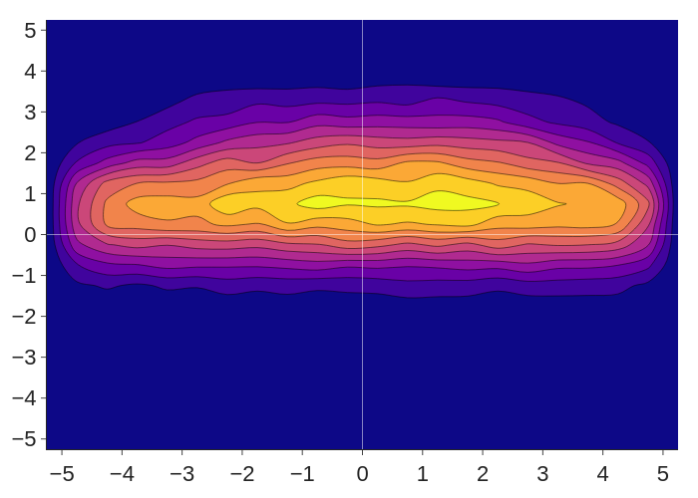

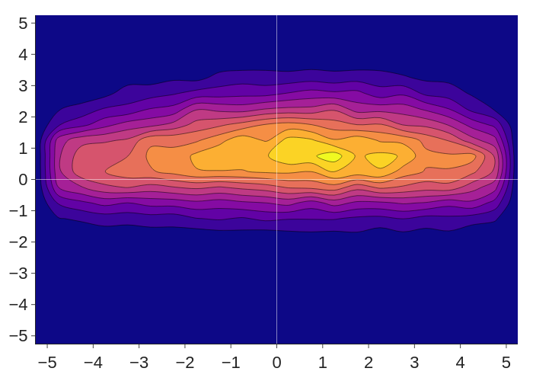
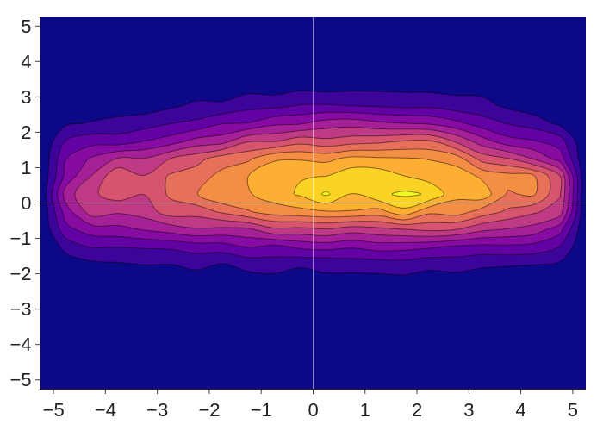
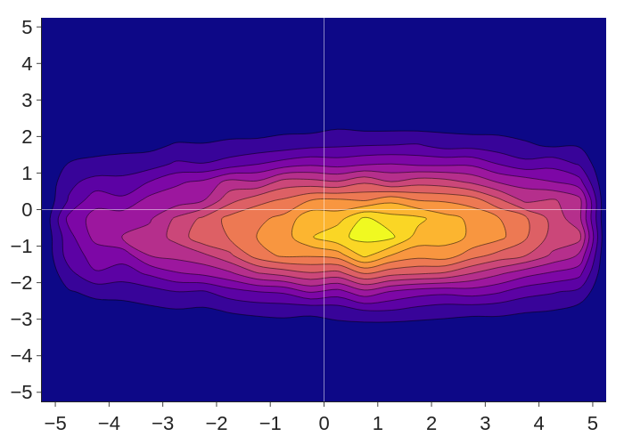



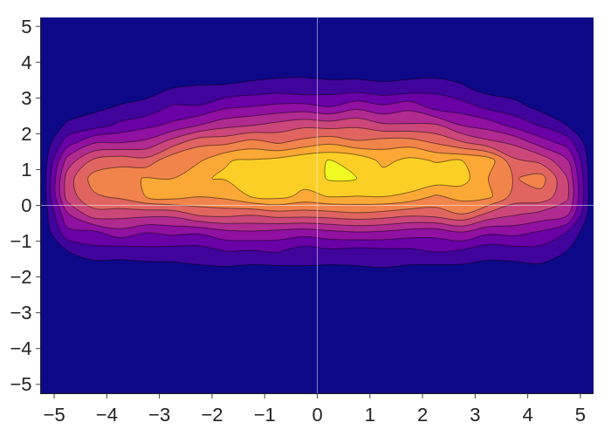
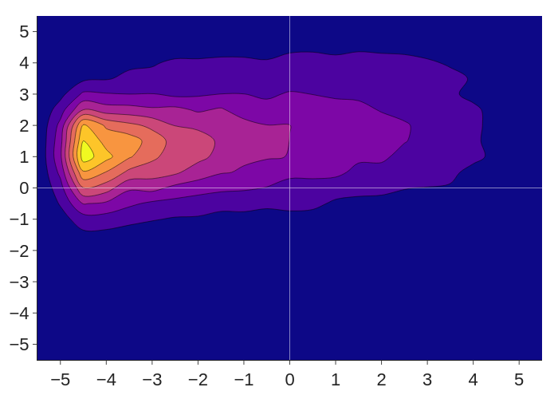
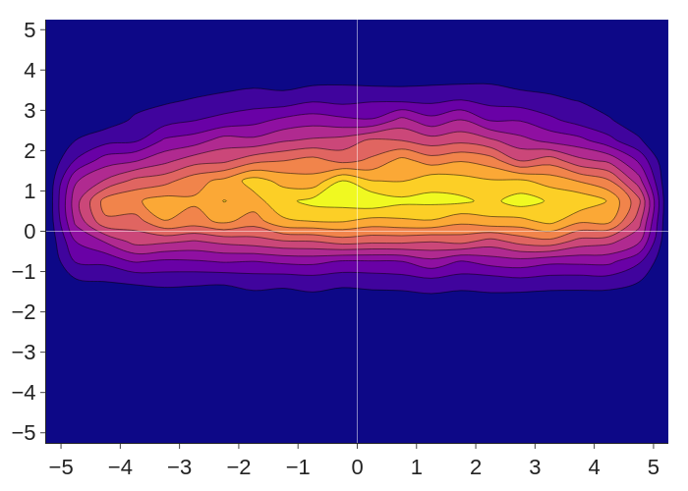
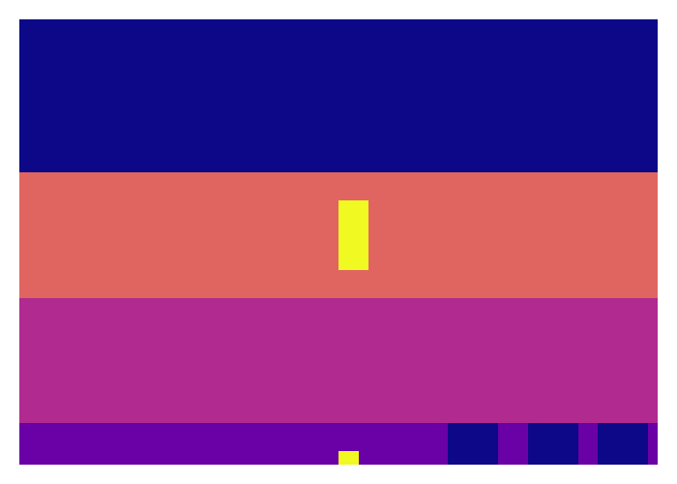
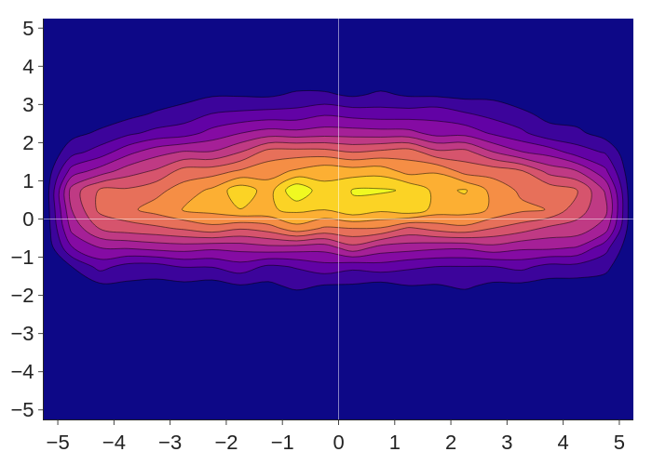

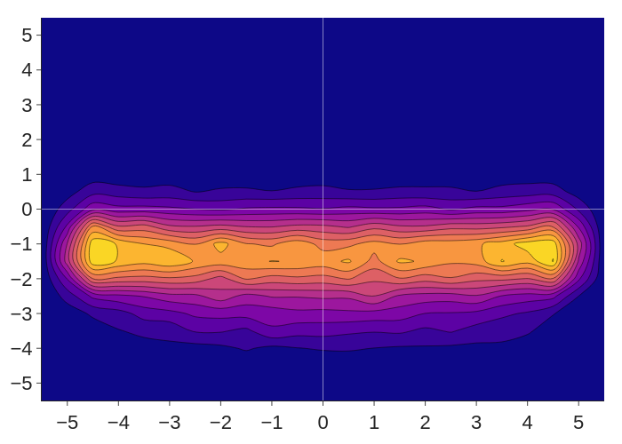
































Qualitative Evaluation (Scenario 06)
Visual input
Distribution
Agent 0
Agent 1
Motivation
Approach
Evaluation
Conclusion
Notes:
Run in scenario 06
Visual map on left, proposal distribution on right
[Dark blue area makes up ~8% of samples]
Agent 0 slows down and turns left when avoiding the obstacle
Agent 1 merges onto middle lane but with 2 modes to avoid other agent
Once merge is complete, both agents accelerate

Slide 12

RL+MCTS vs Baseline
RL+MCTS converges to baseline success rate
RL+MCTS surpasses baseline success rate
Motivation
Approach
Evaluation
Conclusion
Notes:
Training progress for scenario 06 and 08
Uses 200 iterations
Baseline: Pure MCTS with domain-specific heuristics [Pre-calculated maneuvers, Blind values]
Recovers baseline performance for scenario 06
Surpasses baseline performance at around 60 episodes for scenario 08

Slide 13
Wall Clock Time
Scenario 06
Model
Iterations
Success
Wall clock
RL+MCTS
100
0.99
2m43s
Baseline
100
0.99
4s
Scenario 08
Model
Iterations
Success
Wall clock
RL+MCTS
50
0.84
49s
Baseline
400
0.87
57s
Motivation
Approach
Evaluation
Conclusion
Notes:
Scenario 06
Guided MCTS needs the same amount iterations for the same performance
Result: Guided MCTS is slow due to network evaluations [~50% of time spent in search used in network evaluation according to kcachegrind]
Scenario 08
Guided search achieves similar performance using 8 times less iterations
Competitive or improved wall clock time

Slide 14

Scenario 08 vs Scenario 06
Scenario 06
Scenario solvable through basic lane changes
Scenario 08
Requires complex interactions and driving between lanes
Motivation
Approach
Evaluation
Conclusion
Notes:
Question: Why is baseline so good in sc06?
It uses pre-calculated maneuvers [e.g. lane change]
Scenario 06 is solvable through simple lane changes!
Scenario 08 requires driving between lanes
In low iteration settings Pre-calculated maneuvers perform bad -> Baseline performs bad

Slide 15


Mixture Components (Scenario 08)
No significant difference when $K>1$
Multiple mixture components are needed
Motivation
Approach
Evaluation
Conclusion
Notes:
Is a mixture distribution really needed?
Scenario 08 with 200 iterations
K>1 outperforms using Normal distribution only
Marginal differences between mixture models

Slide 16


Mixture Components
Where do multiple components help?
Sampling over whole longitudinal range helps avoid collisions!
Visual input
Sample space
Motivation
Approach
Evaluation
Conclusion
Notes:
Where do multiple components help?
Looking at merge situation from Scenario 08 below: Agent must merge into bottleneck while avoiding collision
GMM helps collision avoidance Sampling across longitudinal action space allows avoiding other agent Distribution narrow enough for bottleneck

Slide 17
Conclusion & Outlook
Conclusion
Efficacy shown
Moderate generalization
Scenario dependent
Limitations
Not efficient
Hard to scale & tune
No model learning
Future work
Scale-up
Variance scaling
Integrating heuristics
Motivation
Approach
Evaluation
Conclusion
Notes:
Conclusion Prototypical implementation verifies approach
Performance is dependent on the scenario Works well for scenario 08, can only recover performance for scenario 06
Generalization Knowledge is transferrable to similar scenarios (although no full success)
Limitations Implementation not maximally efficient (especially C++ inference) Computational demands prevent large-scale experiments Model is given and not learned
Future work Scale-up More scenarios Larger map Harder scenarios Variance rescaling at test time -> Focus more on highly promising regions Integration of heuristic actions into guided MCTS

Slide 18
Reference list
Electrek.co (2021). Watch Tesla Full Self-Driving Beta navigate through the eye of the system in impressive video. https://electrek.co/2021/03/29/tesla-full-self-driving-beta-navigate-video/. Accessed 2021-08-17.
Kurzer, K., Engelhorn, F., & Zöllner, J. M. (2018, November). Decentralized cooperative planning for automated vehicles with continuous monte carlo tree search. In 2018 21st International Conference on Intelligent Transportation Systems (ITSC) (pp. 452-459). IEEE.
Silver, D., Huang, A., Maddison, C. J., Guez, A., Sifre, L., Van Den Driessche, G., ... & Hassabis, D. (2016). Mastering the game of Go with deep neural networks and tree search. nature, 529(7587), 484-489.
Silver, D., Hubert, T., Schrittwieser, J., Antonoglou, I., Lai, M., Guez, A., ... & Lillicrap, T. (2017). Mastering chess and shogi by self-play with a general reinforcement learning algorithm. arXiv preprint arXiv:1712.01815.
Silver, D., Schrittwieser, J., Simonyan, K., Antonoglou, I., Huang, A., Guez, A., ... & Hassabis, D. (2017). Mastering the game of go without human knowledge. nature, 550(7676), 354-359.
Schrittwieser, J., Antonoglou, I., Hubert, T., Simonyan, K., Sifre, L., Schmitt, S., ... & Silver, D. (2020). Mastering atari, go, chess and shogi by planning with a learned model. Nature, 588(7839), 604-609.
Hamrick, J. B., Bapst, V., Sanchez-Gonzalez, A., Pfaff, T., Weber, T., Buesing, L., & Battaglia, P. W. (2019). Combining q-learning and search with amortized value estimates. arXiv preprint arXiv:1912.02807.
Moerland, T. M., Broekens, J., Plaat, A., & Jonker, C. M. (2018). A0C: Alpha zero in continuous action space. arXiv preprint arXiv:1805.09613.
Yang, X., Duvaud, W., & Wei, P. (2020). Continuous Control for Searching and Planning with a Learned Model. arXiv preprint arXiv:2006.07430.
Hubert, T., Schrittwieser, J., Antonoglou, I., Barekatain, M., Schmitt, S., & Silver, D. (2021). Learning and Planning in Complex Action Spaces. arXiv preprint arXiv:2104.06303.
Petosa, N., & Balch, T. (2019). Multiplayer AlphaZero. arXiv preprint arXiv:1910.13012.
Literature

Slide 19
Reference list
Browne, C. B., Powley, E., Whitehouse, D., Lucas, S. M., Cowling, P. I., Rohlfshagen, P., ... & Colton, S. (2012). A survey of monte carlo tree search methods. IEEE Transactions on Computational Intelligence and AI in games, 4(1), 1-43.
Kurzer, K., Fechner, M., & Zöllner, J. M. (2020). Accelerating Cooperative Planning for Automated Vehicles with Learned Heuristics and Monte Carlo Tree Search. arXiv preprint arXiv:2002.00497.
Wang, Q., Wu, B., Zhu, P., Li, P., Zuo, W., & Hu, Q. (2020, June). ECA-Net: efficient channel attention for deep convolutional neural networks, 2020 IEEE. In CVF Conference on Computer Vision and Pattern Recognition (CVPR). IEEE.
Bacchiani, G., Molinari, D., & Patander, M. (2019). Microscopic traffic simulation by cooperative multi-agent deep reinforcement learning. arXiv preprint arXiv:1903.01365.
Vaswani, A., Shazeer, N., Parmar, N., Uszkoreit, J., Jones, L., Gomez, A. N., ... & Polosukhin, I. (2017). Attention is all you need. In Advances in neural information processing systems (pp. 5998-6008).
Haarnoja, T., Zhou, A., Abbeel, P., & Levine, S. (2018, July). Soft actor-critic: Off-policy maximum entropy deep reinforcement learning with a stochastic actor. In International conference on machine learning (pp. 1861-1870). PMLR.
Wang, H., Emmerich, M., Preuss, M., & Plaat, A. (2019, December). Alternative loss functions in alphazero-like self-play. In 2019 IEEE Symposium Series on Computational Intelligence (SSCI) (pp. 155-162). IEEE.
Literature

Slide 20

Generalization Performance
Learned models approximate or exceed baseline performance
Models generalize well to similar scenarios
Random model with heuristic actions is already very strong
Trained model with heuristics is overall the strongest
Backup

Slide 21


Success Rate
$$I_{success}=\max\left(1 −I_{collision}−I_{invalid}−I_{unableContinue}, 0\right)$$
$$P_{success}=\frac{1}{N}\sum_{n=1}^{N}{I_{success}^{n}}$$
$I_{collision}$: Indicator for occurred collision
$I_{invalid}$: Indicator for invalid state, e.g. driving off road
$I_{unableContinue}$: Situation where the algorithm was unable to find actions for an agent

Slide 22



Numerical State in Detail
Information at time step t
$\left(x_{i}\left(t\right), y_{i}\left(t\right)\right)$: Position
$\left(\dot{x_{i}}\left(t\right), \dot{y_{i}}\left(t\right)\right)$: Velocity
$\left(\ddot{x_{i}}\left(t\right), \ddot{y_{i}}\left(t\right)\right)$: Acceleration
$φ_{i}(t)$: Steering angle
Static information
$\left({\dot{x_{i}}}^{\text{desire}}, l_{i}^{\text{desire}}\right)$: Target state
$\left(v_{i}^{\text{width}},v_{i}^{\text{length}}\right)$: Vehicle dimensions
Agent state
History of past 8 dynamic states
Scalar state
Backup
Sources: Moerland et al. (2018), Wang et al. (2019)

Slide 23
Training Wall Clock Time (Scenario 06)
Results are averaged over three models
Iterations | 50 | 100 | 200
Wall clock time | 8h53m | 14h28m | 32h11m
Mean success rate | 0.7686 | 0.7933 | 0.7867
Fast training
Decent success rate over tests with multiple iterations
Trade-off between training time and success
Best performing model
2.5x slower than 50 iterations
Success rate moderately improved
Backup

Slide 24

Resource Consumption
Backup

Slide 25





Loss Function in Detail
Policy loss $ℒ^{π}\left(φ\right)=D_{KL}\left(π_{φ}\left(a | s\right)∥ \hat{π}\left(a | s\right)\right){=𝔼}_{a∼π_{φ}(a|s)}\left[\log{π_{φ}\left(a | s\right)−\log{{\hat{π}}_{φ}\left(a|s\right)}}\right]$
Entropy loss $ℒ^{H}\left(φ\right)=H\left(π_{φ}\left(a | s\right)\right)=𝔼_{a∼π_{φ}(a|s)}\left[−\log{π_{φ}\left(a | s\right)}\right]$
Value loss $ℒ^{V}\left(φ\right)=𝔼_{s∼𝒟}\left[{\left(V_{φ}\left(s\right)−\hat{V}\left(s\right)\right)}^{2}\right]$
$$ℒ(φ)=$$
$$ℒ_{i}^{π}\left(φ\right)$$
$$−α_{i}ℒ_{i}^{H}\left(φ\right)$$
$$+ℒ_{i}^{V}(φ)$$
Backup
Sources: Moerland et al. (2018), Wang et al. (2019)

Slide 26




Entropy Correction
Goal: Express density of transformed distribution $π(a|s)$ in terms of untransformed distribution $μ\left(u | s\right)$
From the change of variables formula and the multivariable inverse function theorem, we know that
Plugging the derivative into ${\left|\text{det} \frac{d a}{d u}\right|}^{−1}$
Simplifying using the logarithm rules
Backup

Slide 27

Importance of Loss Components
Learning purely driven by policy loss
Backup

Slide 28

Reward for Scenario 08
Baseline achieves highest reward for lowest success rate
Reward is hand-crafted with possibly suboptimal parameters
Other student worked on this via IRL
Backup

Slide 29

Full Results for Scenario 06

Slide 30





Efficient Channel Attention (ECA)
Enforce weights $s∈(0, 1)$ through sigmoid
Global average pooling over $H×W$ dimensions of $X$
Recalibrate the feature map $X$ with the learned weights $s$
Learn interactions with $1×1$ convolution
Backup

Slide 31
Lookout & Pitfalls
Instability of GMM policies in RL
Instability of Transformers in RL
MCTS
+
RL
Averaging over agents in loss
Generating enough training data
Inaccuary of entropy estimation
Discretization vs continuous control
Backup
Sources: Huber et al. (2008), Tian et al. (2019), Parisotto et al. (2019)

